Slide 1
Datasets manipulation and visualization with Jupyter
and Pandas
Section 15
Notes:
[Mandatory Slide] This would be the introduction slide of the topic that you are covering in this section.
When this slide plays, you could talk about the main aim that we’d be covering in this section.

Slide 2
What We’ll Learn
Installing Jupyter and managing a notebook
Reading and writing datasets
Visualizing datasets
Cleaning and manipulating datasets
Pandas data structures
Jupyter is a web tool for fast code prototyping, supporting interactive data science
Pandas offers excellent support for loading/dumping data from/to a variety of formats
The easiest way to make sense out of a dataset is plotting it
Pandas is a Python library providing high-performance data manipulation and analysis tools
A common example of time-related datasets is financial data

Slide 3
Installing Jupyter and managing a notebook
Notes:
[Mandatory Slide] This would be the introduction slide of the topic that you are covering in this subsection.
When this slide plays, you could talk about the main aim that we’d be covering in this video.

Slide 4
In this Video, we are going to take a look at…
Meet Jupyter
Installing Jupyter
Code sample: managing a notebook
Notes:
[Mandatory Slide]
Before the start of the video, we’d like to highlight what are important topics or pointers that we’d be covering in this video. This slide would immediately follow the intro/name slide. This would just be say 2-3 points for the viewers to know what they are getting into.

Slide 5
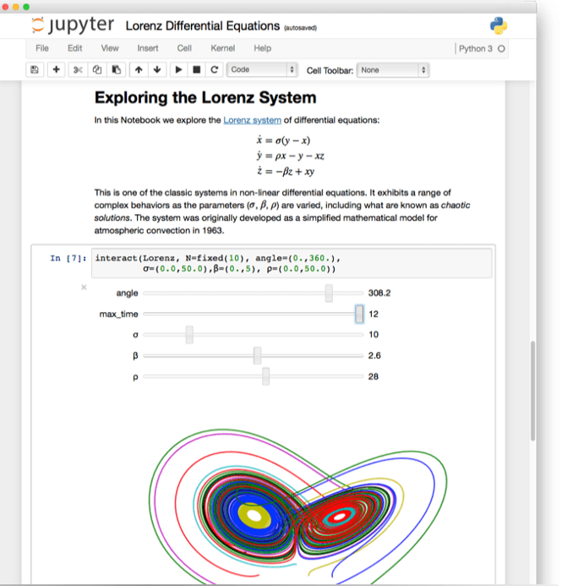
Meet Jupyter
Jupyter is a is an open source web-based data science tool
It is web application that you can use to create and share documents containing live code, visualizations and rich text elements: such documents are called notebooks
Notebooks can be viewed and edited on the client-side of Jupyter web app and the code is then run on the server-side of it
Notebooks are polyglot
Notebooks are “snippet-oriented”: this means that you can only run one snippet of code (called “cell”) at a time
This
takes Jupyter closer to a “visual command-line” than to an IDE
makes Jupyter a great tool for code prototyping and quick data exploration and visualization
Notes:
[Mandatory Slide]
Before the start of the video, we’d like to highlight what are important topics or pointers that we’d be covering in this video. This slide would immediately follow the intro/name slide. This would just be say 2-3 points for the viewers to know what they are getting into.

Slide 6
Jupyter
vs
PyCharm
Jupyter
Line-by-line execution
Good for code prototyping and data visualization
Almost no productivity tools
PyCharm
Script/app execution
Good for structured codebases
Productivity tools (debugging, syntax-highlight, SCM integration)
A quick comparison

Slide 7


Installing Jupyter
You can install Jupyter simply with:
pip install jupyter
The Jupyter Notebook Server can be launched
From PyCharm
From the command line with: jupyter-notebook
Once started, the web interface is available on: http://127.0.0.1:8888/tree
Notes:
[Mandatory Slide]
Before the start of the video, we’d like to highlight what are important topics or pointers that we’d be covering in this video. This slide would immediately follow the intro/name slide. This would just be say 2-3 points for the viewers to know what they are getting into.

Slide 8
Code Sample: managing a notebook
Notes:
Something that needs to grab the viewers attention!!

Slide 9
Summary
Meet Jupyter
Installing Jupyter
Code sample: managing a notebook
Notes:
[Mandatory Slide]
Before the start of the video, we’d like to highlight what are important topics or pointers that we’d be covering in this video. This slide would immediately follow the intro/name slide. This would just be say 2-3 points for the viewers to know what they are getting into.

Slide 10
Pandas data structures
Next Video
Notes:
[Mandatory Slide]
Here the name of the next video needs to be mentioned. The narration as you guessed it would be just letting the viewer know exactly where we are at and what we’d be taking over next! ☺

